Slide 1
Class 3: Training a Simple Neural Network by Hand

Slide 2
Training a Neural Network by Hand
Today's goal: understand how NNs learn
Walk through forward and backward passes
Update weights over a few steps (epochs)
Manual learning = strong intuition for automation later

Slide 3

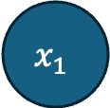
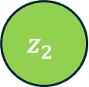
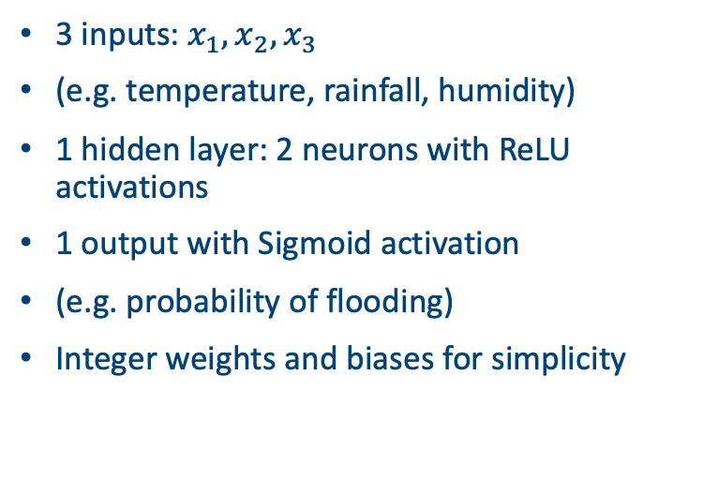
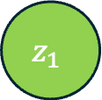

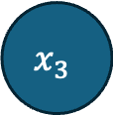

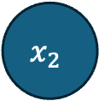

The Network Structure 3-2-1
$$x_{1}$$
$$h_{1}=ReLU(z_{1})$$
$$z_{1}$$
3 inputs: $x_{1}, x_{2}, x_{3}$
(e.g. temperature, rainfall, humidity)
1 hidden layer: 2 neurons with ReLU activations
1 output with Sigmoid activation
(e.g. probability of flooding)
Integer weights and biases for simplicity
$$x_{2}$$
$$z_{o}$$
$$z_{2}$$
$$\hat{y}=σ(z_{o})$$
$$x_{3}$$
$$h_{2}=ReLU(z_{2})$$

Slide 4
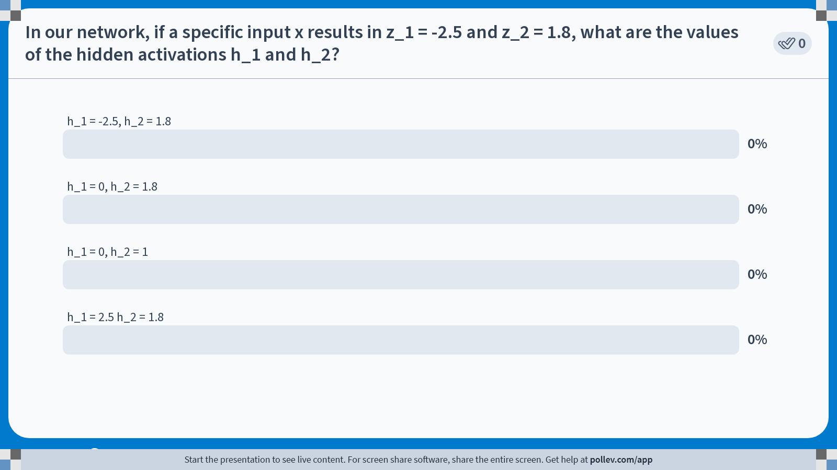
Notes:
Do not modify the notes in this section to avoid tampering with the Poll Everywhere activity. More info at polleverywhere.com/support In our network, if a specific input x results in z_1 = -2.5 and z_2 = 1.8, what are the values of the hidden activations h_1 and h_2?
https://www.polleverywhere.com/multiple_choice_polls/G2QogxeXGHOTBWTu8yCa0?state=opened&flow=Default&onscreen=persist

Slide 5



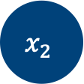






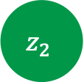





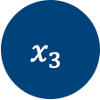


Now with weights!
$$x_{1}$$
$$w_{11}$$
$$h_{1}=ReLU(z_{1})$$
$$w_{21}$$
$$z_{1}$$
$$w_{o1}$$
$$+b_{o}$$
$$w_{12}$$
$$+b_{1}$$
$$x_{2}$$
$$z_{o}$$
$$w_{22}$$
$$+b_{2}$$
$$w_{o2}$$
$$w_{13}$$
$$z_{2}$$
$$\hat{y}=σ(z_{o})$$
$$w_{23}$$
$$x_{3}$$
$$h_{2}=ReLU(z_{2})$$

Slide 6
Input and Target
One input vector: [1, 0, 1]
Target output (label): 1
So this is a classification model
Goal: network output should approach 1 over time
On the board: for given weights and biases compute the forward pass

Slide 7
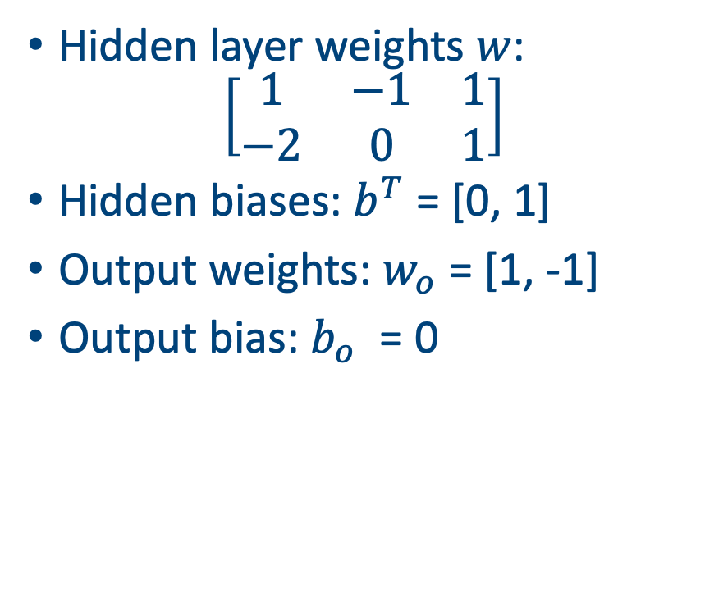
Initialize Weights and Biases
Start with all weights small, but helpful if they’re non-zero
All biases = 0
Will update over training using error signal
Small integers make learning interpretable
Hidden layer weights $w$:
$$\left[\begin{matrix}1 & −1 & 1 \\ −2 & 0 & 1\end{matrix}\right]$$
Hidden biases: $b^{T}$ = [0, 1]
Output weights: $w_{o}$ = [1, -1]
Output bias: $b_{o}$ = 0
On the board: for these given weights and biases compute the forward pass

Slide 8

Compute Loss
Use Binary Cross-Entropy:
$$L = −[y log⁡(\hat{y}) + (1−y) log⁡(1 −\hat{y})]$$
Compare network output to target label
Loss is high if output far from target
Loss tells us how ‘wrong’ the current weights and biases are
Loss is high → backpropagation needed
We will now update weights

Slide 9
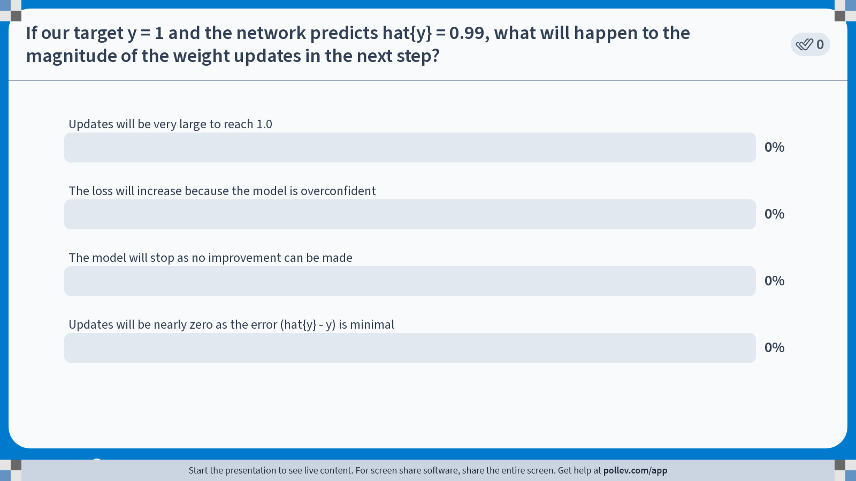
Notes:
Do not modify the notes in this section to avoid tampering with the Poll Everywhere activity. More info at polleverywhere.com/support If our target y = 1 and the network predicts hat{y} = 0.99, what will happen to the magnitude of the weight updates in the next step?
https://www.polleverywhere.com/multiple_choice_polls/JZznzugwkVdpZNiwRE2Af?state=opened&flow=Default&onscreen=persist

Slide 10
Now perform backpropagation
Compute error at the output layer
Adjust output weights to reduce the error
Propagate error backward to hidden layer
Weights are updated to reduce future errors

Slide 11
Overall algorithm
Initialize all weights and biases (e.g., to 0 or small integers). 2. For each epoch: a. Forward pass: i. Compute hidden layer pre-activations: z₁ = w₁·x + b₁, z₂ = w₂·x + b₂ ii. Apply ReLU activation: h₁ = ReLU(z₁), h₂ = ReLU(z₂) iii. Compute output layer input: zₒ = wₒ·h + bₒ iv. Apply Sigmoid activation to get prediction: ŷ = σ(zₒ) b. Compute Loss: i. Use Binary Cross-Entropy: L = -[y·log(ŷ) + (1−y)·log(1−ŷ)] c. Backward pass: i. Compute gradient of loss with respect to output weights ii. Backpropagate error to hidden weights only if ReLU > 0 d. Update parameters: i. Adjust weights and biases with gradient steps ii. Stop after desired number of epochs
On the board: go through all the steps!

Slide 12
Epoch 2 – Forward Again
Run forward pass with updated weights
Compute new hidden activations and output
Expect output closer to target = 1
ReLU and Sigmoid continue to change values
Go through epoch 2 on the board

Slide 13
Summary of Epoch 2
Output moved closer to 1
Loss dropped compared to Epoch 1
Learning rate was effective
Track all parameter values again

Slide 14
Compare Epochs – Learning Trace
Usually we display outputs of loss function over epochs
Can also show weight evolution side-by-side
Biggest changes usually in early epochs
Later epochs just refine the pattern
(wandb package useful for monitoring runs)

Slide 15
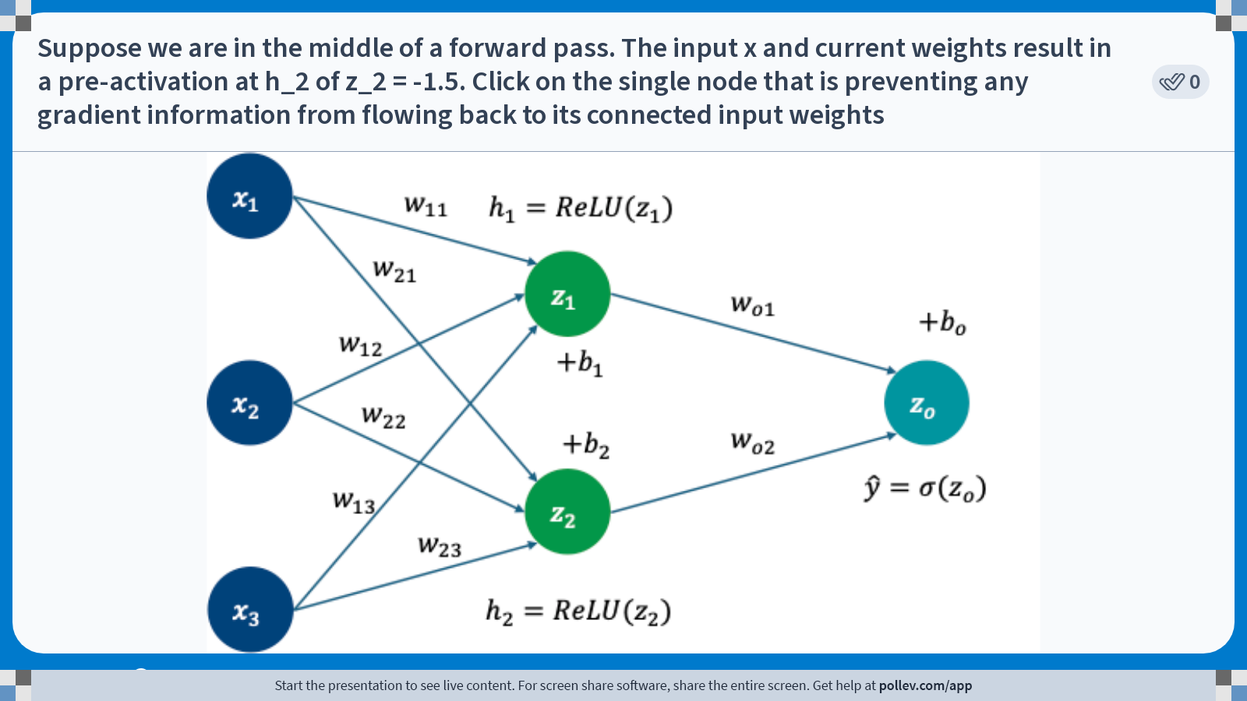
Notes:
Do not modify the notes in this section to avoid tampering with the Poll Everywhere activity. More info at polleverywhere.com/support Suppose we are in the middle of a forward pass. The input x and current weights result in a pre-activation at h_2 of z_2 = -1.5. Click on the single node that is preventing any gradient information from flowing back to its connected input weights
https://www.polleverywhere.com/clickable_images/yRk7j8s6JV63O3Z1SD3Is

Slide 16
Practice Suggestions
Change input: try [0,1,1] or [1,1,1]
Try other initial weights and compare convergence
Use two training examples
Try tanh activation instead of ReLU
A simpler version to this (with derivatives given) will be on the exam!

Slide 17
Summary
It’s a lot of work (and fiddly calculation) to go through a full forward and backward pass of even a simple NN
All the calculations though are pretty straightforward
Easy to make small mistakes. Marks given for process not accuracy

